Slide 1
Secret Communication using cryptography & steganography
Youssef Mohamed abdelshahid
ID: 2022/05890

Slide 2
Table of content
What is Cryptography?
Types of cryptography
Rsa cryptography
What is steganography?
Image steganography
Lsb method
Crypto-steganography
Testing and results
applications

Slide 3
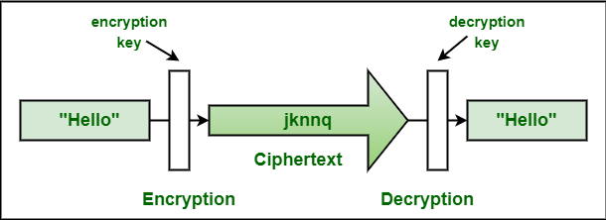
What is cryptography?
Cryptography is a method of protecting information and communications using codes, so that only those for whom the information is intended can read and process it.

Slide 4
Types of cryptography
There are three types of cryptography:
Symmetric Key Cryptography (e.g. DES, AES, etc.)
Asymmetric Key Cryptography (e.g. RSA)
Hash Function

Slide 5
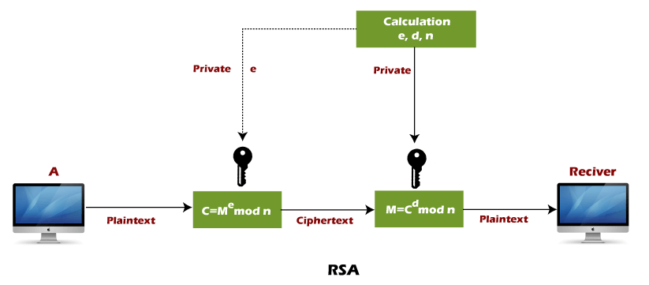
RSA cryptography
RSA is the most common public-key algorithm, named after its inventors Rivest, Shamir, and Adelman (RSA).

Slide 6
What is steganography?
Steganography is the art and science of writing hidden messages in such a way that no one, apart from the sender and intended recipient, suspects the existence of the message, a form of security through obscurity.

Slide 7
Image steganography
Using image files as hosts for steganographic messages takes advantage of the limited capabilities of the human visual system
It is the practice of concealing information within the data of digital images without altering their visual appearance. The hidden data can include text, images, audio, or any other form of binary information.

Slide 8
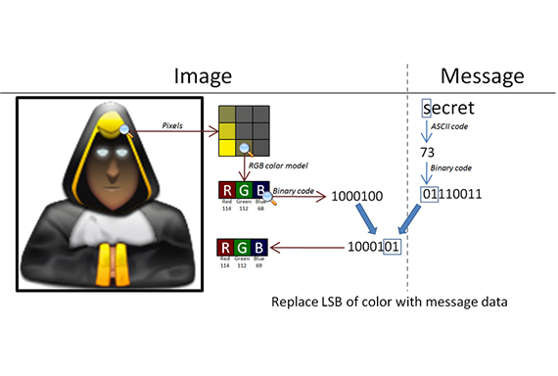
Lsb (least significant bit) method
LSB steganography is a commonly used technique for hiding secret messages within images. It works by replacing the least significant bits of the cover image with the secret message bits.

Slide 9
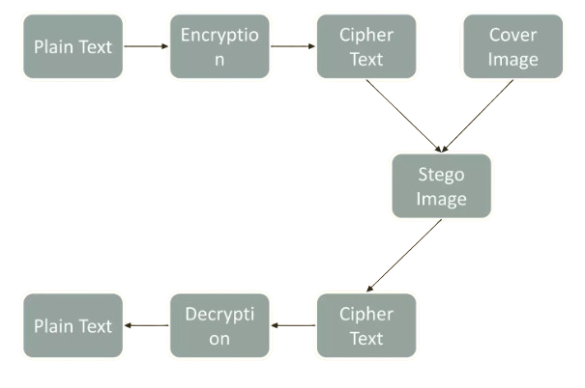
Combined crypto-steganography
Crypto-steganography is a technique that combines cryptography and steganography to enhance the security of information.

Slide 10
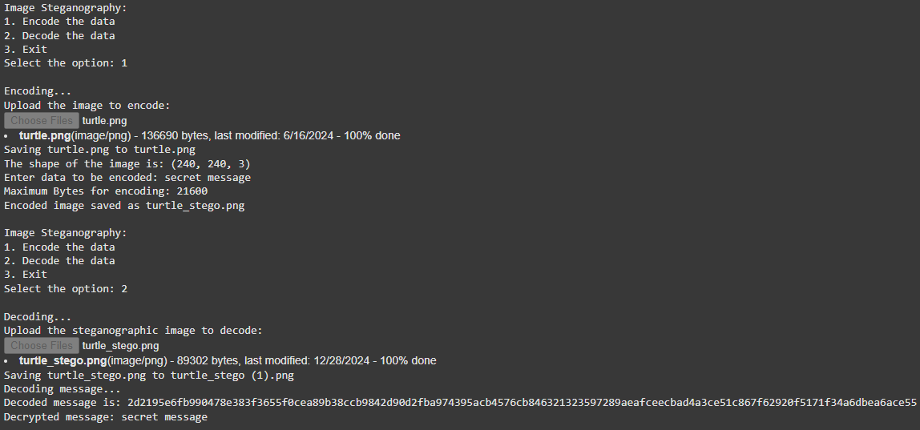
testing

Slide 11
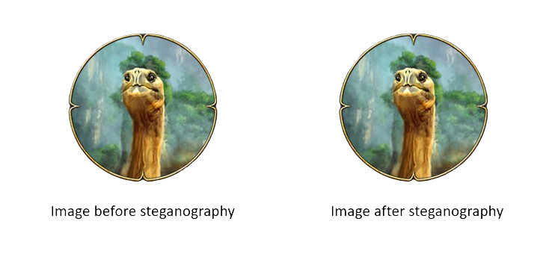
Result

Slide 12
Applications
Secret communication (e.g. military, intelligence agencies, etc.)
Digital Watermarking
Authentication systems (where encrypted hidden data is used to validate users or devices)
Health and Medical Records (Ensures secure storage and transfer of encrypted patient data embedded in medical images, like MRI scans)
And many more…

Slide 13
references
https://www.javatpoint.com/rsa-encryption-algorithm
https://www.researchgate.net/publication/269524396_A_Crypto-Steganography_A_Survey
https://www.geeksforgeeks.org/image-steganography-in-cryptography/

Slide 14
Thank you!

